Slide 1
Network Flow

Slide 3
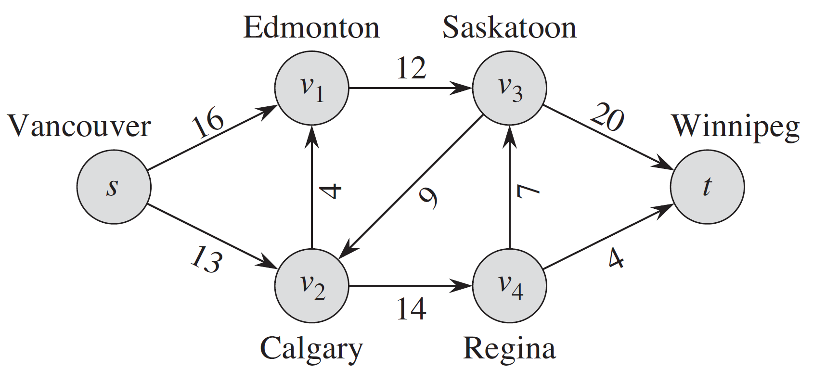
Motivation
A directed graph can be interpreted as a “flow network”
This can help us to solve many material flow related problems.
Example:
Imagine a material coursing through a system from a source, where the material is produced, to a sink, where it is consumed.
The source produces the material at some steady rate, and the sink consumes the material at the same rate.
Flow networks can model many
problems, including liquids flowing
through pipes, parts through
assembly lines, current through
electrical networks, and information
through communication networks.

Slide 4
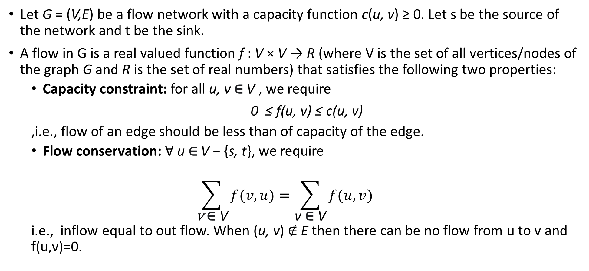
Flow networks
Let G = (V,E) be a flow network with a capacity function c(u, v) ≥ 0. Let s be the source of the network and t be the sink.
A flow in G is a real valued function f : V × V → R (where V is the set of all vertices/nodes of the graph G and R is the set of real numbers) that satisfies the following two properties:
Capacity constraint: for all u, v $\text{∈}$ V , we require
0 ≤ f(u, v) ≤ c(u, v)
,i.e., flow of an edge should be less than of capacity of the edge.
Flow conservation: Ɐ u ∈ V − {s, t}, we require
$$\sum_{\text{v} \text{∈} \text{V}}{f(v, u)}=\sum_{\text{v} \text{∈} \text{V}}{f(u, v)}$$
i.e., inflow equal to out flow. When (u, v) ∉ E then there can be no flow from u to v and f(u,v)=0.

Slide 5
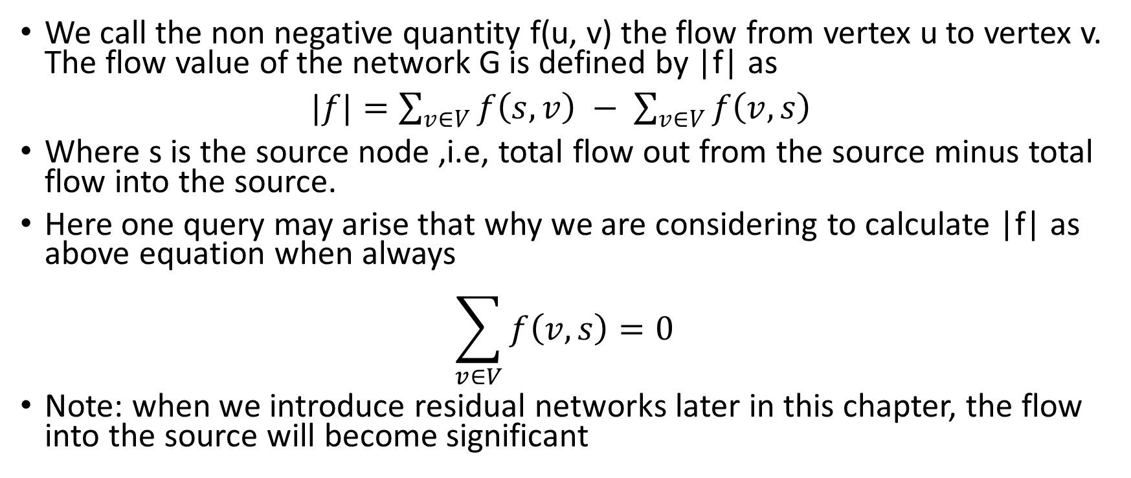
Flow value
We call the non negative quantity f(u, v) the flow from vertex u to vertex v. The flow value of the network G is defined by |f| as
$|f|=\sum_{v∈V}{f\left(s, v\right) − }$ $\sum_{v∈V}{f\left(v,s\right) }$
Where s is the source node ,i.e, total flow out from the source minus total flow into the source.
Here one query may arise that why we are considering to calculate |f| as above equation when always
$$\sum_{v∈V}{f\left(v, s\right)=0 }$$
Note: when we introduce residual networks later in this chapter, the flow into the source will become significant

Slide 6
Lets see a greedy algo:
Find a path from s to t for which flow exist
Find the flow using bottleneck edge and add the flow to total flow
Update the graph
Repeat step 1 to 3 until no flow is possible

Slide 7
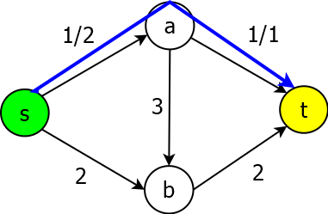
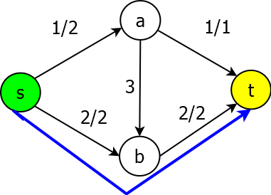
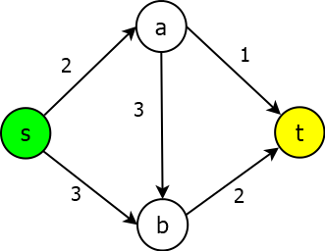
Example
Path-1: s->a->t
Path-2: s->b->t
Total Flow = 3 unit

Slide 8
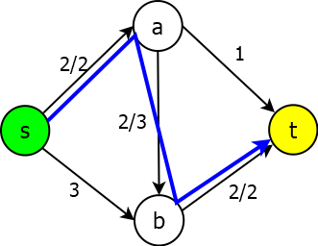
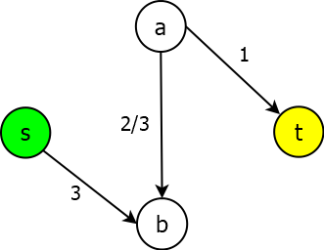
Need of Backward Edges: Residual Graph
Path-1: s->a->b->t
Path-2: Not possible
Total Flow = 2 unit
What is the problem???

Slide 9
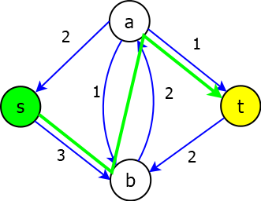
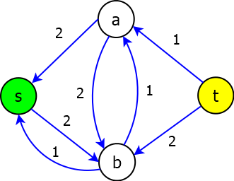
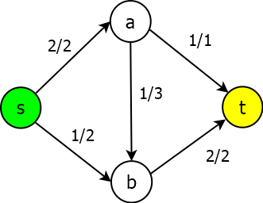
Need of Backward Edges: Residual Graph
Total Flow-3

Slide 10
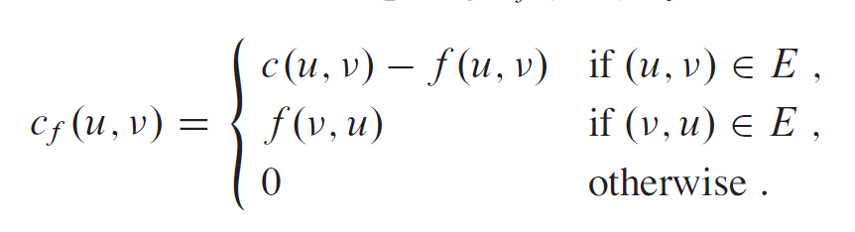
Residual networks
Suppose that we have a flow network G = (V, E) with source s and sink t. Let f be a flow in G, and consider a pair of vertices u, v ϵ V.
We define the residual capacity c_{f}(u, v)by
flow in G, and consider a pair of vertices u, v ϵ V.
We define the residual capacity cf(u, v)by

Slide 11
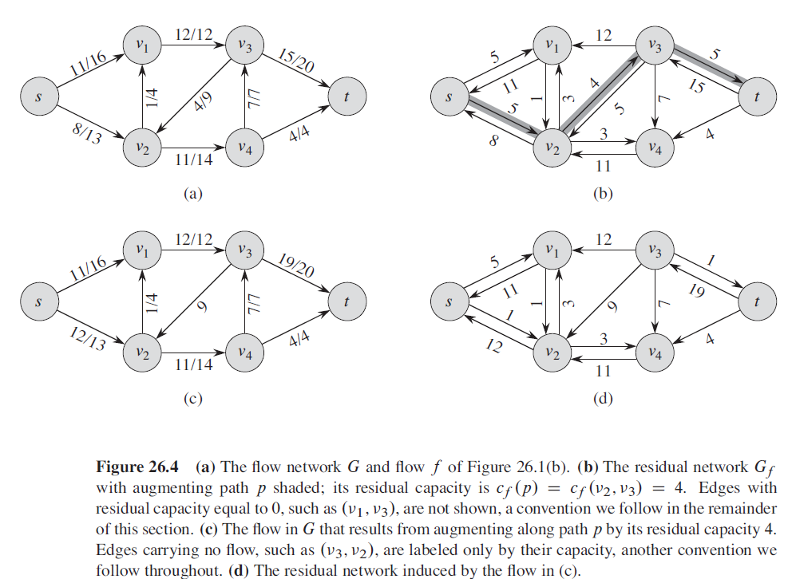

Slide 12
Augmenting paths:
Given a flow network G=(V,E) and a flow f, an augmenting path is a simple path from s to t in the residual network G_{f}.
Residual capacity of p : the maximum amount of net flow that we can ship along the edges of an augmenting path p, i.e., c_{f}(p)=min{c_{f}(u,v):(u,v) is on p}.
2
3
1
The residual capacity is 1.

Slide 13
The Ford-Fulkerson method
We call it a “method” rather than an “algorithm” because it encompasses several implementations with differing running times.
The Ford-Fulkerson method depends on three important ideas: residual networks, augmenting paths, and cuts.
FORD-FULKERSON-METHOD (G, s, t)
1 initialize flow f to 0
2 while there exists an augmenting path p in the residual network G_{f}
3 augment flow f along p
4 return f
Here G_{f} is residual network

Slide 14
The Ford-Fulkerson method repeatedly augments the flow along augmenting paths until it has found a maximum flow.
How do we know that when the algorithm terminates, we have actually found a maximum flow?
The max-flow min-cut theorem, tells us that a flow is maximum if and only if its residual network contains no augmenting path.
To prove this theorem, though, we must first explore the notion of a cut of a flow network.

Slide 15
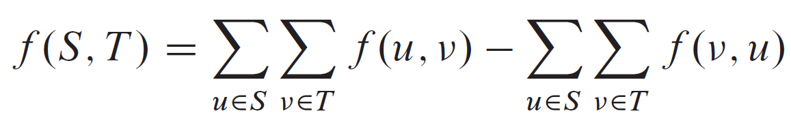
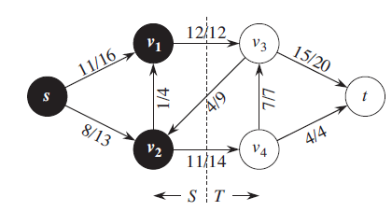
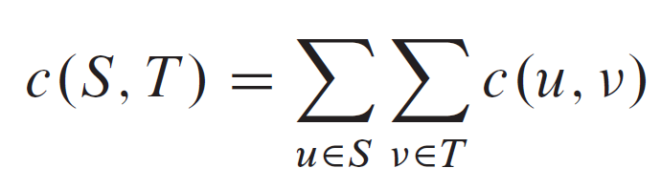
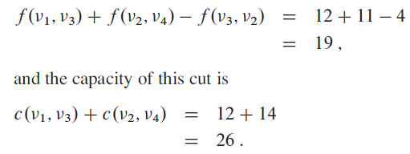
Cuts of flow networks
A cut (S, T) of flow network G = (V,E) is a partition of V into S and T = V - S such that s ϵ S and t ϵ T .
f is a flow, then the net flow f (S, T) across the cut (S, T) is defined to be
The capacity of the cut (S, T) is
A minimum cut of a network is a cut whose capacity is minimum over all cuts of the network.
The net flow across this cut is
A minimum cut of a network is a cut whose capacity is minimum over all cuts of the network.

Slide 16
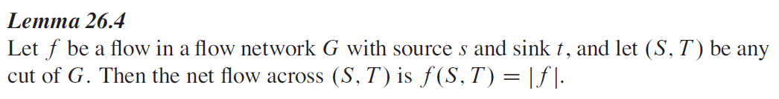
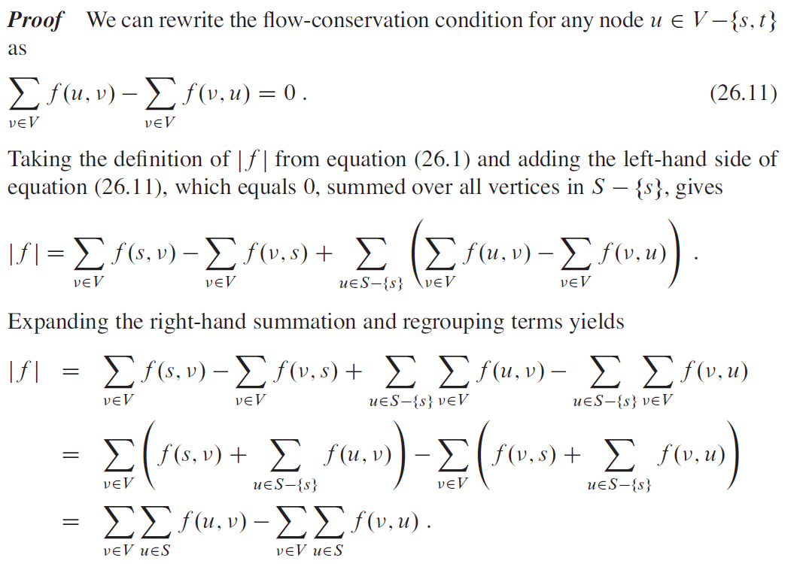

Slide 17
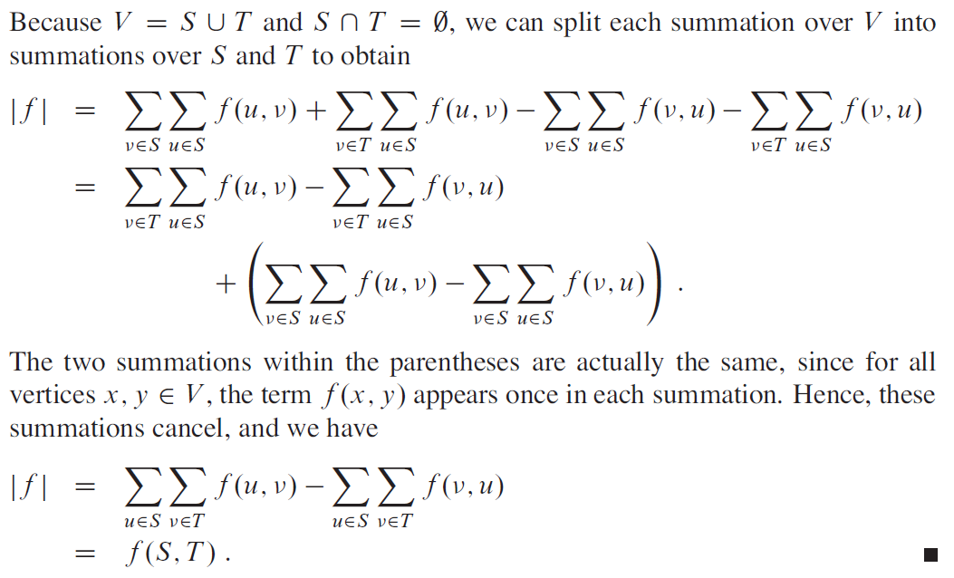

Slide 18
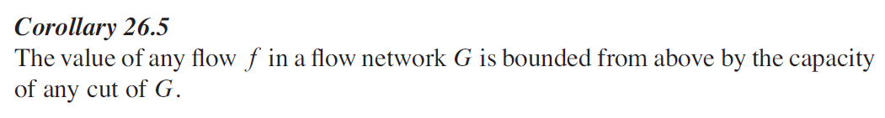
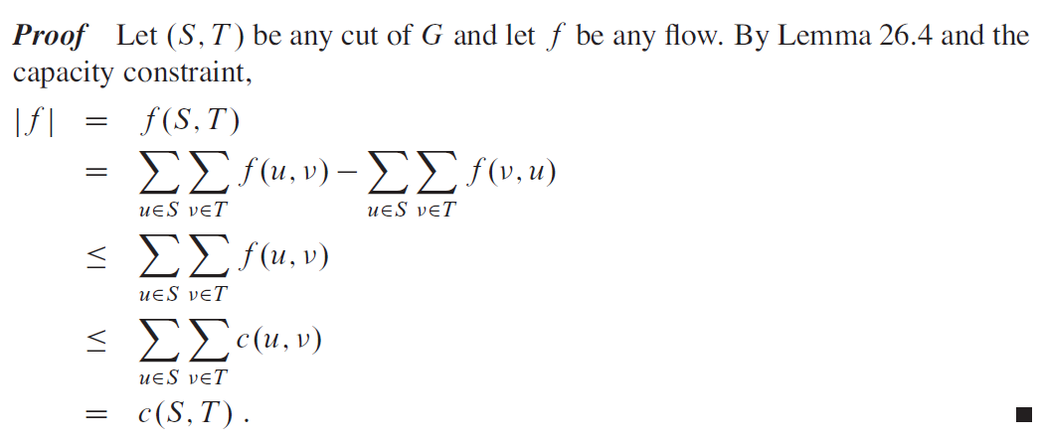

Slide 19
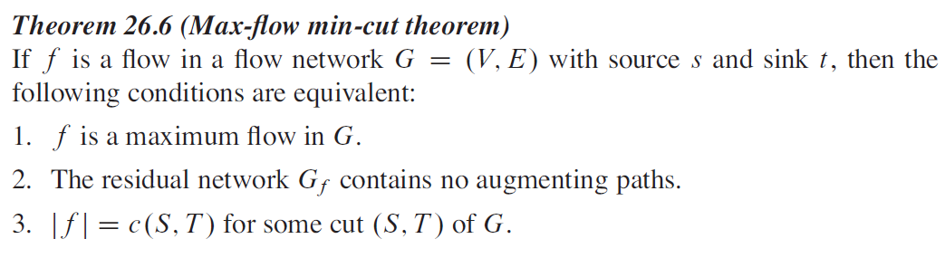
Max-flow min-cut theorem

Slide 20

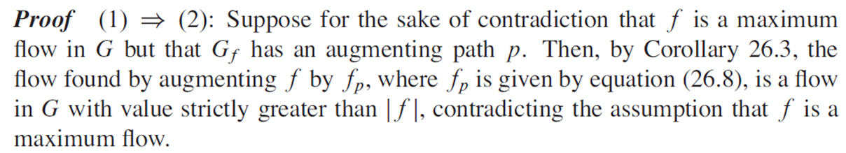
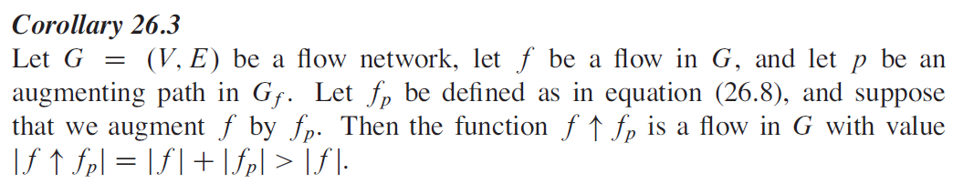
The residual network Gf contains no augmenting paths

Slide 21
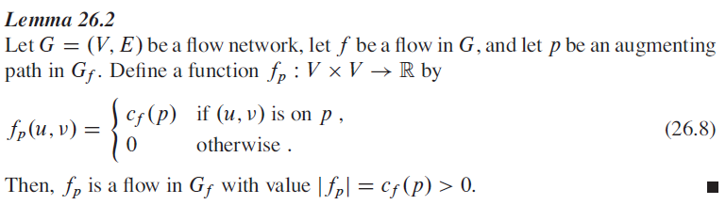

Slide 22
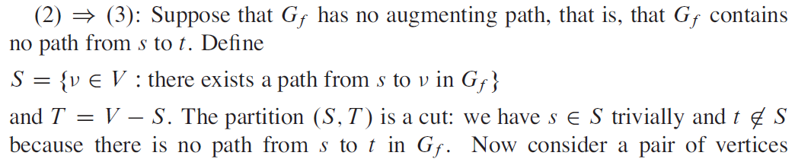
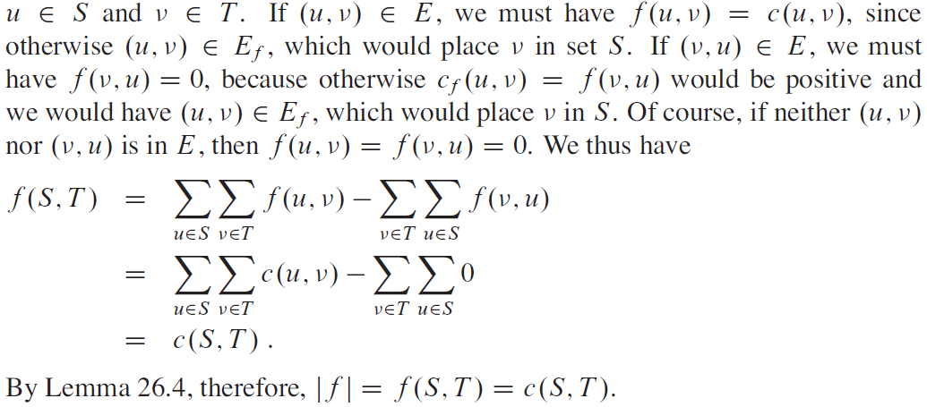
The residual network Gf contains no augmenting paths

Slide 23
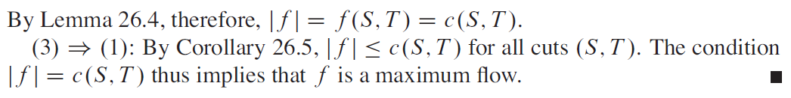

Slide 24
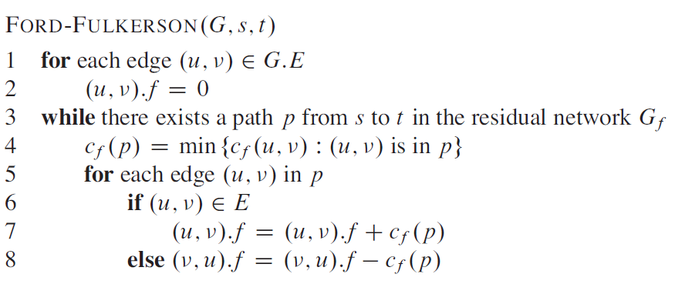
The basic Ford-Fulkerson algorithm

Slide 25
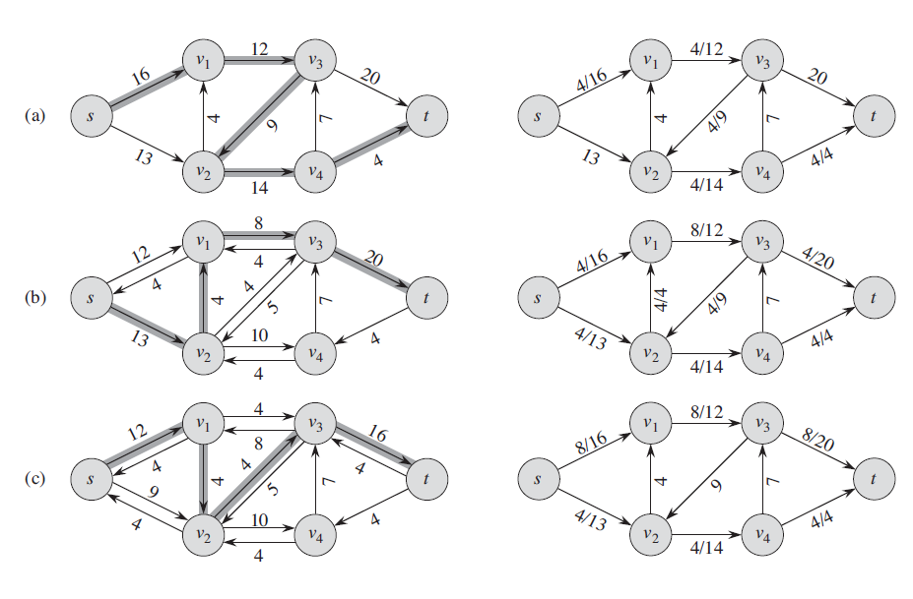

Slide 26
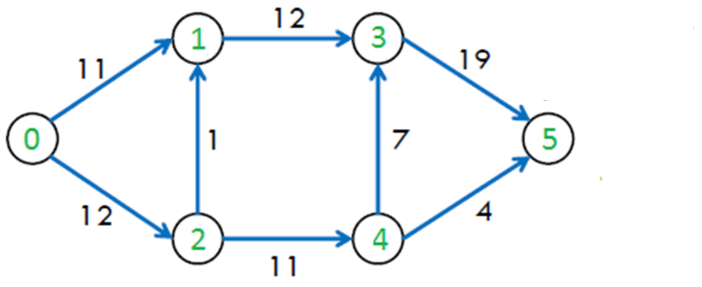
Question-1

Slide 27
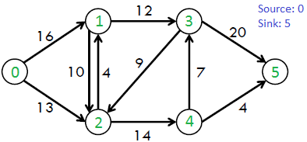
Question-2

Slide 28
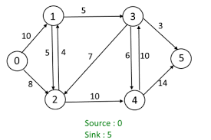
Question-3

Slide 29
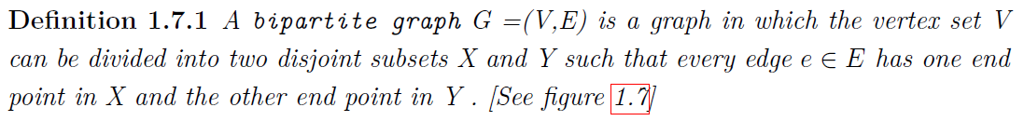
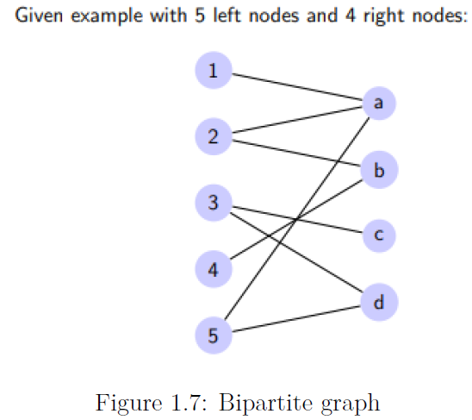
Bipartite Matching: Application of flow network

Slide 30
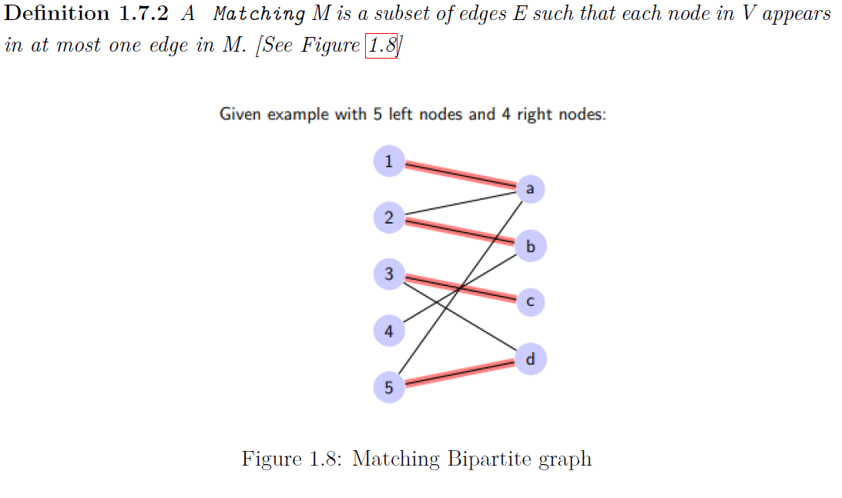

Slide 31
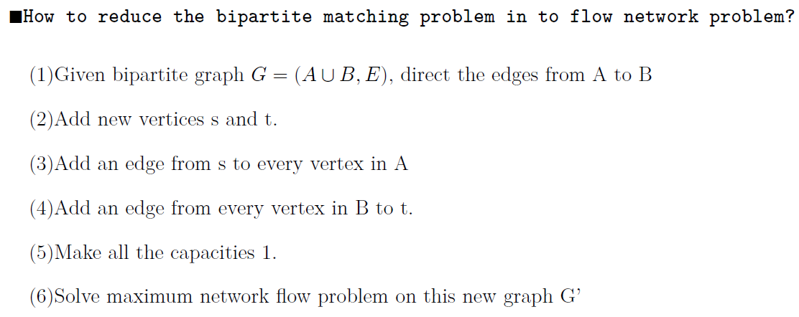

Slide 32
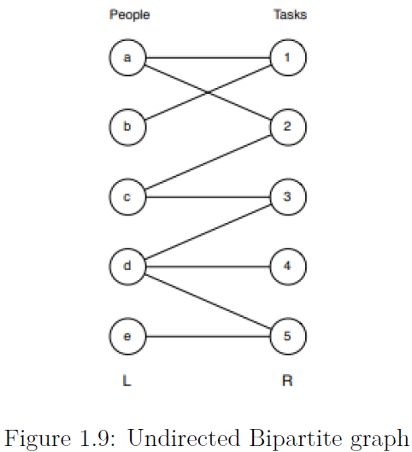
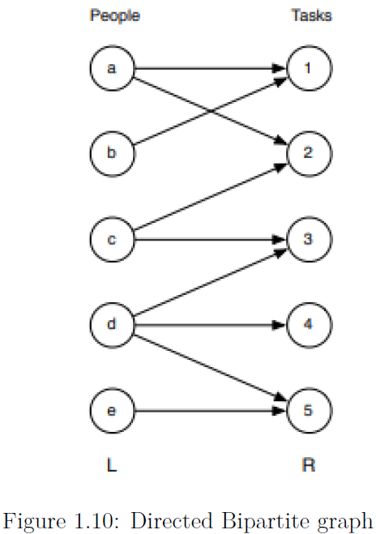

Slide 33
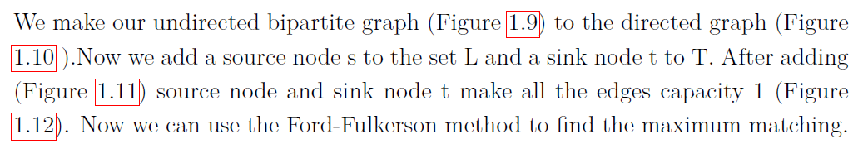
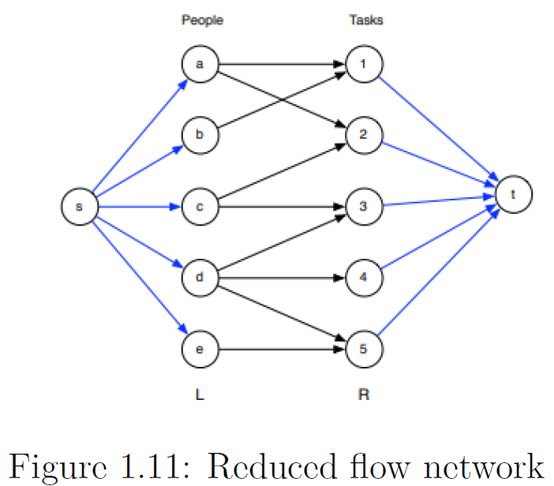
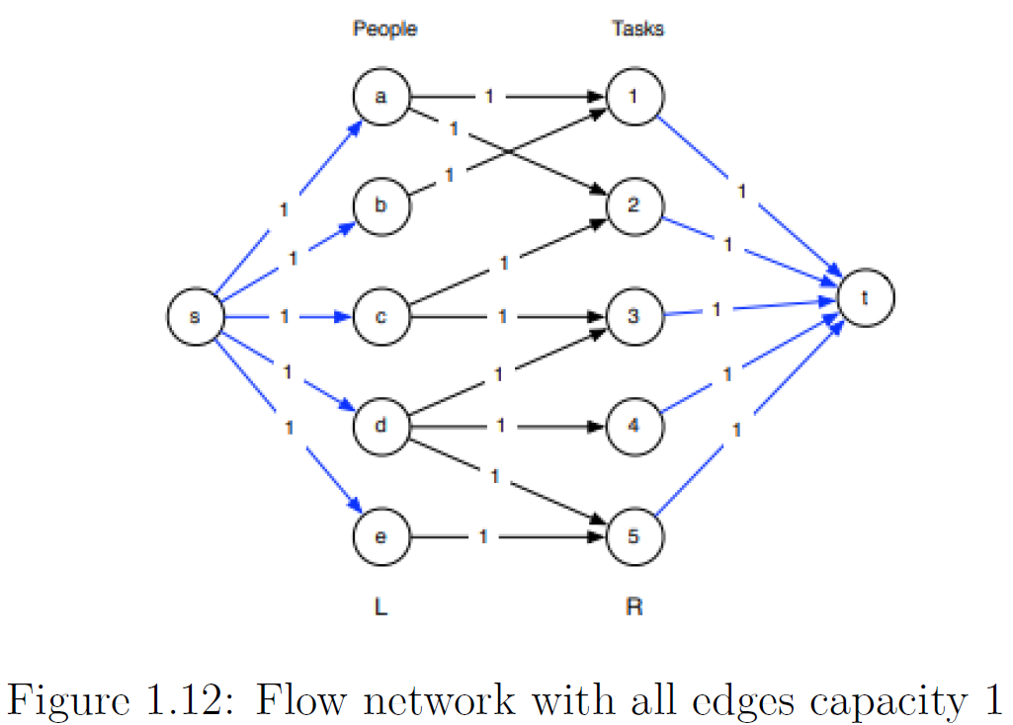

Slide 34
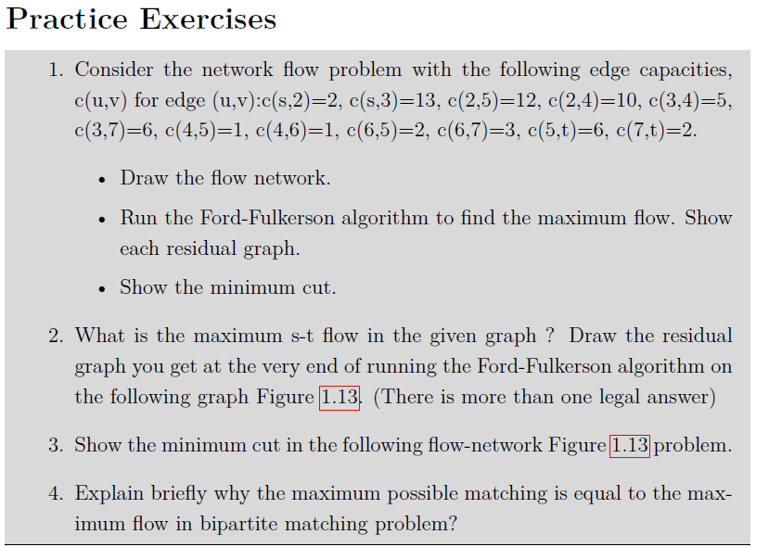

Slide 35
